Slide 1
SENTIMENT ANALYSIS OF BRITISH AIRWAYS REVIEWS
Insights and Analysis of Customer Sentiment.
Presented By : Kintan Pitaloka W
February 6, 2025 (update version)

Slide 2
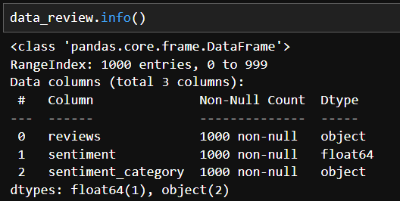
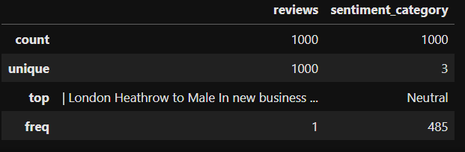
OBJECTIVE
To analyze the sentiment of customer reviews for British Airways and gain insights into customer satisfaction.
This dataset contains information about the dataset itself, including the number of columns and rows. It consists of 1,000 entries, 3 columns, and no missing data.
In conclusion, there are 1,000 reviews, with the majority categorized as neutral in sentimen

Slide 3
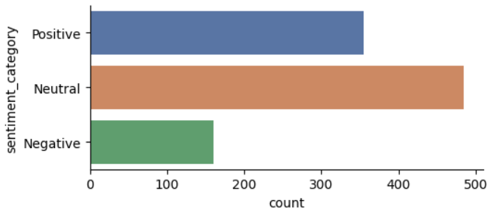
INSIGHTS & CONCLUSION
As we can see from the insights we learned from the dataset :
There are 1000 reviews, with the top review being 'London Heathrow to Male In new business..’
There are 3 sentiment categories: positive, neutral, and negative.
Positive have frequent 385, Neutral 485, and Negative 160.
The most frequent sentiment is neutral, with 485 occurrences.

